Slide 1
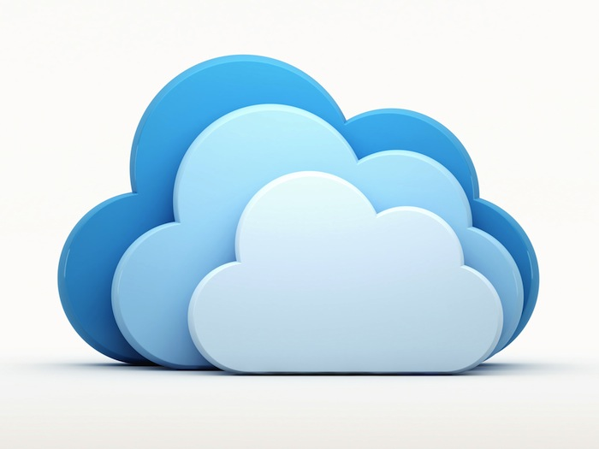
Team 11 – Software Product Line Architecture For Cloud Based Applications
Authors:
Mayur Mehta A20405901
Suyog Kharage A20402686
Yash Kotadiya A20402140

Slide 2
Program Agenda
Introduction to Software Product Lines (SPL)
Cloud Computing
Usage of SPL in cloud applications
Benefits of SPL
Conclusion
Reference

Slide 3
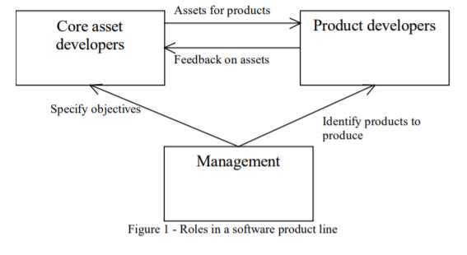
Introduction to Software Product Lines (SPL)
A software product line is a set of software-intensive systems sharing a common, managed set of features that satisfy specific needs of a particular market.
Core asset developers provide a range of assets, such as architectures, specifications, and implementations, to product developers for their use in producing products.
Product line managers coordinate and facilitate the work of these two groups
The three main goals of a software product line are to reduce cost, improve delivery time, and improve quality.
Core assets include shared components, infrastructure, tools, process, documentation, and above all else, shared architecture.

Slide 4
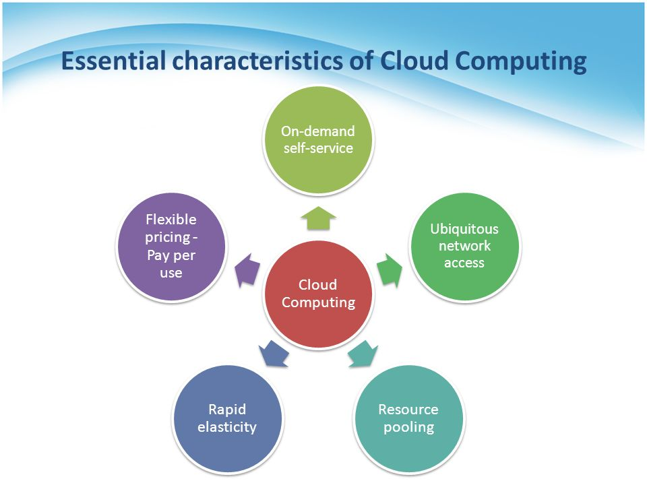
Cloud Computing
Five Essential Characteristics
On-demand Usage: Request services as and when required.
Resource Pooling: Dynamic allocation of resources such as storage, processing, memory and network bandwidth to meet every consumer’s demands.
Ubiquitous network access: Access the services though network-connected devices e.g. Mobile phones, Laptops, Tablets etc.
Measured service: Resource usage can be monitored, controlled, and reported upon by providers and consumers alike.
Elasticity (Scalability): Scale the cloud capability up or down.

Slide 5
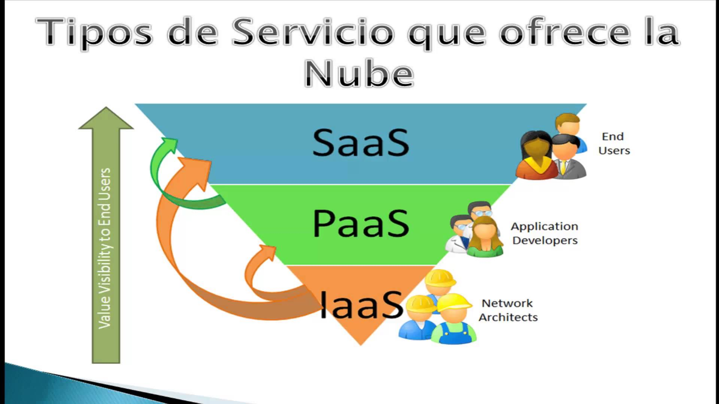
Cloud Computing - Continued
Software as a Service (SaaS)
SaaS is a software delivery model where a fully functional and complete software product is delivered to end users over the web as per the subscription.
End user access SaaS services through a web browser on the basis of
pay per use or on monthly subscription. SaaS offerings are the most widely visible of all the cloud computing service models. In fact, many users might be using SaaS products without even realizing it. Popular products like Office365 and Salesforce are major SaaS offering services and are used by thousands of businesses every day.
Examples of SaaS are Office 365 and Salesforce
Advantages of SaaS are: 1) Reduced Time 2) Lower Costs 3) Scalability and Integration 4) Easy to use.

Slide 6
Cloud Computing - Continued
Platform as a Service (PaaS)
Platform as a Service, referred to as PaaS, is a type of cloud computing platform and environment using which developers build applications and services over the internet. PaaS services are generally hosted in the cloud and accessed by end users via their web browser.
Developers use PaaS regularly from conception to the creation of applications, through to testing and deployment
Like SaaS, PaaS is generally used on a subscription basis and clients only pay for what they use. Sharing of underlying infrastructure results in economies of scale
Google’s App Engine, IBM BlueMix, and Apache’s Stratos are popular examples of PaaS products.
Advantages of PaaS – 1) Flexibility 2) Adaptability 3) Don’t have to invest in physical infrastructure.

Slide 7
Cloud Computing - Continued
Infrastructure as a Service (IaaS)
In IaaS, pre-configured hardware resources are provided to users through a virtual interface. Unlike PaaS and SaaS, IaaS doesn’t include applications or even an operating system, it simply enables access to the infrastructure needed to power or support that software.
IaaS can provide extra storage for corporate data backups, network bandwidth for a company website server, or it can even enable access to high power computing which was previously only accessible to those with supercomputers.
Popular IaaS offerings like Amazon EC2, IBM SoftLayer, and Google’s Compute Engine (GCE)
Advantages of IaaS – 1) Cost Saving 2) Faster time to market 3) Focus on business growth

Slide 8
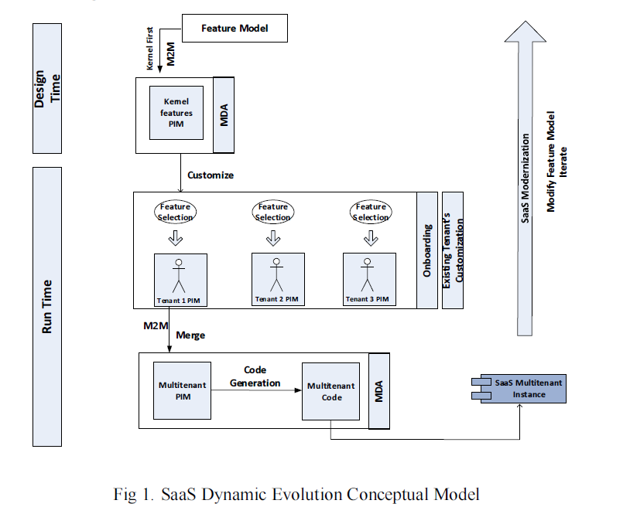
Usage of SPL in cloud applications
Model Driven Architecture in SaaS
If there is a requirement to build a Multi-Tenant Single Instance application that specifically aid each tenant based on the requirement then,
Proposed solution using SPL: A multi-tenant single instance SaaS evolution platform based on Software Product Lines (SPLs).
This model consist of 3 phases : SaaS Kernel development, new tenants onboarding and existing tenant’s customization.
It provides a tenant specific application.
It delivers customizable versions of SaaS using SPL principles.
MDA is an approach adopted by the Object Management Group (OMG) to provide reusable solutions addressing the whole development lifecycle.

Slide 9
Benefits of SPL
SPL engineering aims at building software while ensuring quality, reliability and reduction of cost, efforts and time-to-market.
The definition of variabilities and commonalities, known as variability modeling, is a main activity in SPL engineering.
SPL also eliminates the risk factors and improves the quality of product.
Moreover there is portable staff which can work on multiple functionalities.
Increased Predictability.

Slide 10
Comparative Analysis
Paper | Models Used | Examples
Towards Software Product Lines Based Cloud Architecture | Demonstrated the applicability of the variability model for SaaS applications. | Salesforce CRM uses this approach.
Towards Software Product Lines Based approach to adapt IaaS Cloud configurations | Makes use of model driven development (MDD) techniques | Microsoft Azure and Openstack provides IaaS Services
Cloud based Software Product Lines | Uses variability model for SaaS applications | Bosch uses this model apart from Salesforce.

Slide 11
Conclusion
Cloud computing is one of the emerging technologies that is disrupting traditional way of doing business. We reviewed Software Product Line approach for solving the issues related to development of applications in cloud.
Below is the summary of the reviews:
The Software Product Line variability models are being used for modeling SaaS applications in order to adapt them to end user’s needs.
The Feature model approach provides a feature oriented solution for SaaS applications.
The Model Driven development (MDD) is being used in IaaS applications to achieve cloud platform independence.

Slide 12
References
‘Review of Software Product Line Models Used to Model Cloud applications’ – IEEE paper http://ieeexplore.ieee.org/document/6616430/
‘Cloud Based Software Product Lines’ - https://dl.acm.org/citation.cfm?id=2364440
‘Towards a Software Product Line-based approach to adapt IaaS cloud configurations’ IEEE paper http://ieeexplore.ieee.org/document/7881665/
‘Towards Software Product Lines Based Cloud Architecture’ – IEEE paper http://ieeexplore.ieee.org/document/6903464/

Slide 13
Thank You

